Slide 1
A ST 511 – M70 Statistical Data Analytics
Professor: Dr. Charlotte Gard
Data Analytics Project 2 Submission
By Lohith Siva venkata ramakrishna

Slide 2
Background
The United States incurs $55.6 billion annually in medical malpractice costs, constituting 2.4 percent of total healthcare spending. A study spanning 1991 to 2005 revealed that 7.4 percent of all licensed US physicians faced malpractice claims
These numbers have a major effect on healthcare costs and raise the cost of medical malpractice insurance. An insurance company is examining documents that detail claim payments as well as details about the doctors and claimants involved in recently settled or adjudicated cases in order to better understand payouts for medical malpractice cases.

Slide 3
Methods
An explanation of distributions:
For the distributions of age, severity, and payment amount, use histograms.
Make a bar plot to distribute the information about whether or not a private attorney was hired.
The connection between payment size and age:
Use age as a predictor and payment size as the outcome in a linear regression analysis. Examine the p-value; a significant relationship is indicated if it is less than the significance level (e.g., 0.05).
Connection between Payment Size and Severity:
Use payment size as the outcome and severity as the predictor in a linear regression. In order to determine statistical significance, evaluate the p-value.
Dependency on Legal Representation by a Private Attorney:
For claimants who are represented by a private attorney versus those who are not, compare the severity-payment size relationship. Regression models can be used independently or combined with an interaction term in a single model.
Should the interaction term hold significance, it implies variations in the relationships between severity and payment size contingent on the attorney's representation.
Consider using statistical software for analysis and visualization, such as R or Python, along with the necessary libraries to perform regressions and produce visualizations such as bar plots and histograms. Analyze the results taking into account the limitations of the methodology and statistical significance.

Slide 4
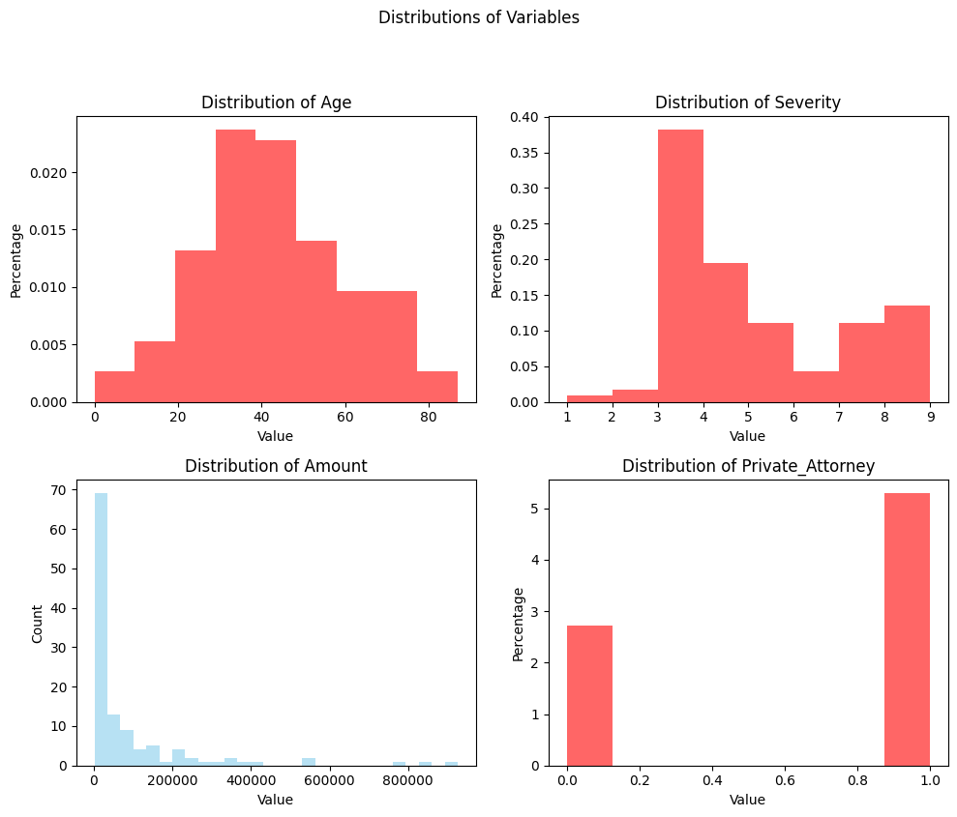

Slide 5
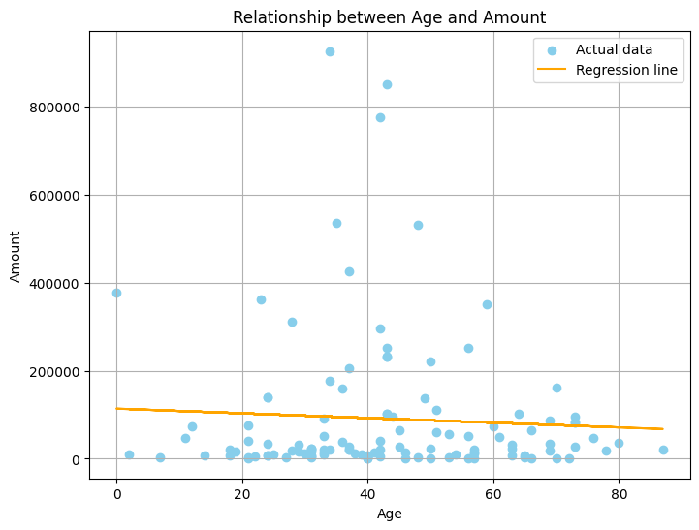

Slide 6
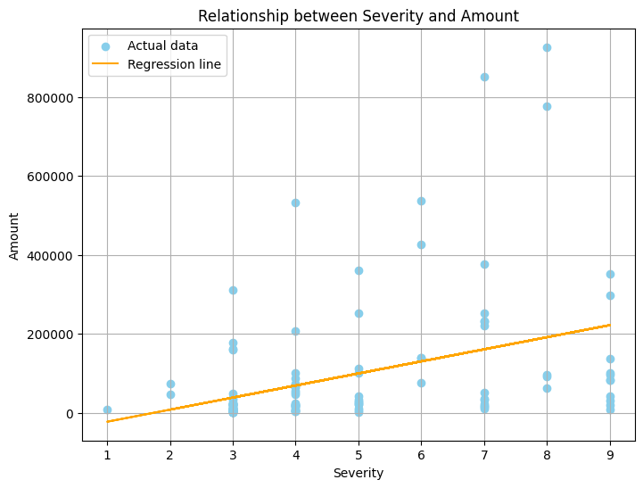

Slide 7
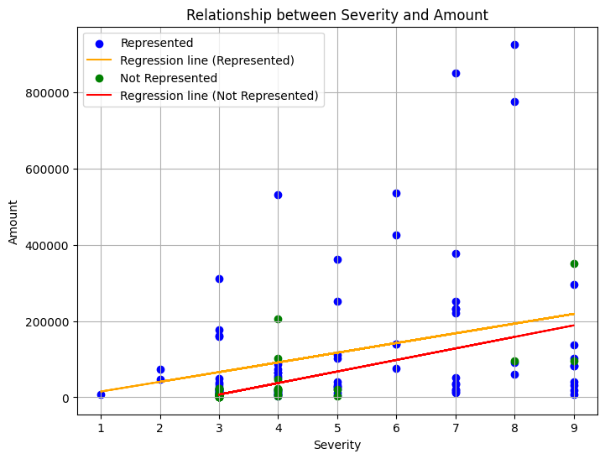

Slide 8
Backup slides

Slide 9
Backup Slide 1: Comparison of Claim Payments Over Time
Objective: Address potential questions about trends in claim payments over time.
Content:
Line chart displaying claim payment amounts over different years or time periods.
Annotations or trend lines to highlight any notable fluctuations or trends.
Insights on whether claim payment amounts have been stable, increasing, or decreasing over time.
Narrative: This backup slide provides a historical view of claim payments, helping to contextualize any variations or patterns observed over different periods. It assists in understanding the long-term trend in claim payment amounts.

Slide 10
Backup Slide 2: Geographical Distribution of Claims
Objective: Address potential questions regarding the geographical distribution of claims.
Content:
Map visualization showing the geographical locations where claims originate.
Color-coded markers or shading to indicate the density or amount of claims in different regions.
Additional information such as hotspots or clusters of high claim activity.
Narrative: This slide provides insights into the geographic distribution of claims, potentially highlighting regions with higher claim frequency. It aids in understanding if certain areas have a higher concentration of claims, prompting considerations for regional risk assessments or targeted interventions.

Slide 11
Backup Slide 3: Claim Outcome by Physician Specialty
Objective: Address queries about the influence of physician specialties on claim outcomes.
Content:
Bar or box plot comparing claim payment sizes across different physician specialties.
Statistical summaries (mean, median, quartiles) or error bars to depict variability among specialties.
Insights into whether specific specialties are associated with larger or smaller claim payments.
Narrative: This slide examines how claim payment sizes vary across various physician specialties. It helps in understanding if certain specialties are more prone to higher claim payments, potentially indicating areas for targeted risk management or further investigation.

Slide 12
Thankyou
By Ram

